Slide 1



For more than 20 years, Duarte has developed visual stories for the world’s leading corporate brands, thought leadership forums, and an Academy Award-winning documentary.
Now they bring you…
FIVE RULES FOR CREATING GREAT PRESENTATIONS
Notes:
To view this presentation, first, turn up your volume and second, launch the self-running slide show.

Slide 2


To View This Presentation
FIRST
Turn Up Your Volume
SECOND
Launch Self-Running Slide Show
Notes:
To view this presentation, first, turn up your volume and second, launch the self-running slide show.

Slide 3







Notes:
Presentations are a powerful communication medium.

Slide 4

Notes:
For more than 20 years, Duarte has developed presentations…

Slide 5



D
Notes:
…to launch products,

Slide 6
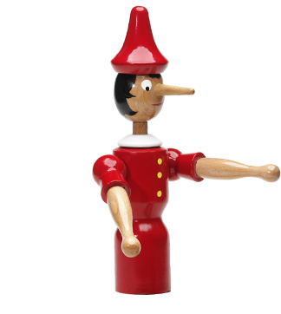
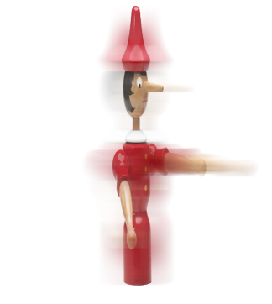
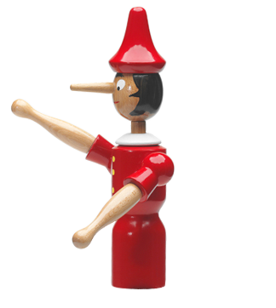
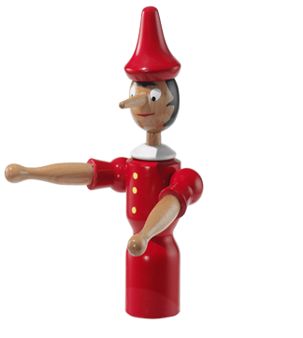

Notes:
…align employees,

Slide 7
Notes:
…increase company value,

Slide 8
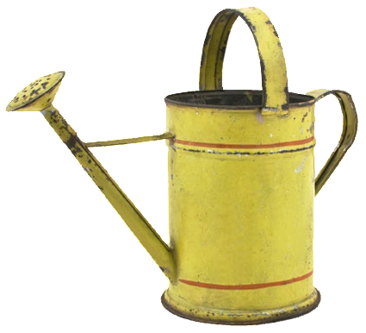
Notes:
…and propel

Slide 9














Notes:
…global causes.

Slide 10
Urban Photo Album
Notes:
This template can be used as a starter file for a photo album.

Slide 11
NEW PICTURE EFFECTS
Introducing

Slide 12
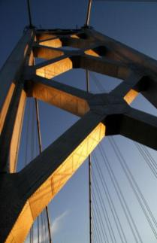

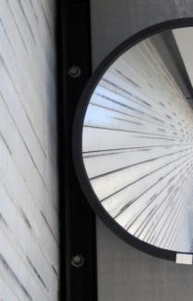



Before
After
Tone
Saturation
Color
You can use Picture Color to change the tone or saturation of your picture or to recolor it to a single color

Slide 13

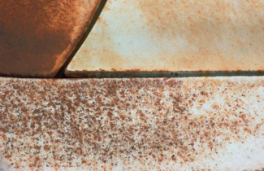
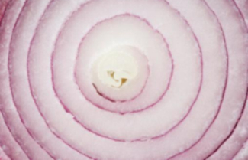

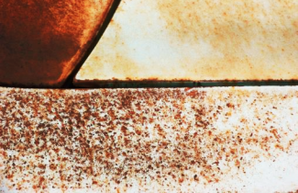
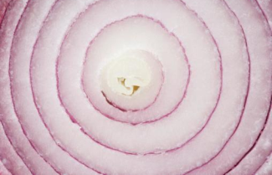
Before
After
Contrast
Brightness
Sharpness
Corrections allow you to change the contrast, brightness, and sharpness of your images.

Slide 14
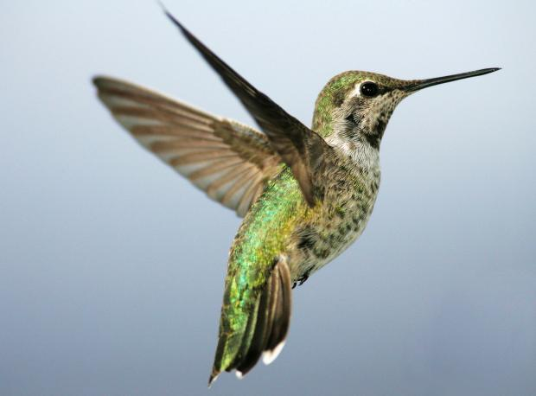
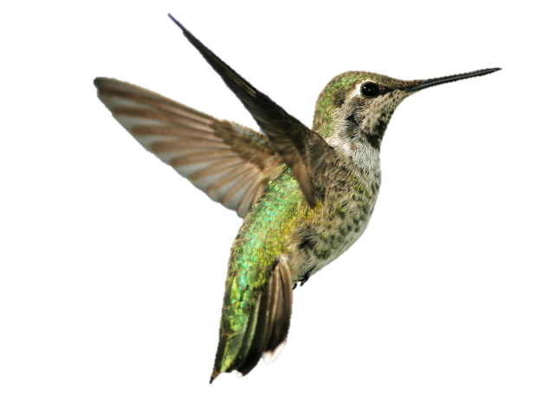
Focus on the Star of Your Photo
Background Removal allows you to quickly and easily remove backgrounds to isolate items in your image.

Slide 15
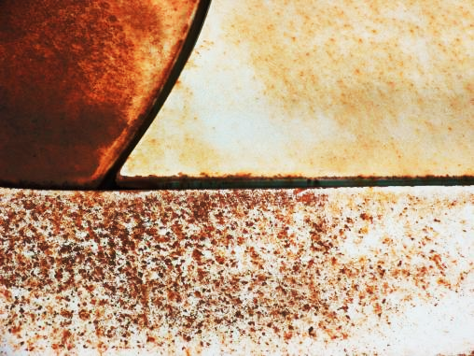

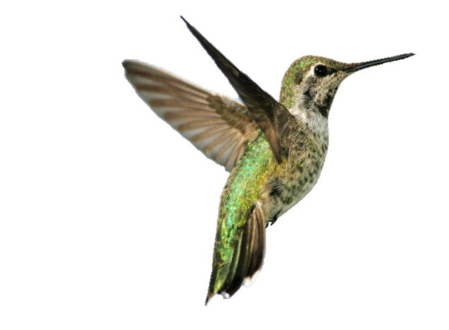
By layering multiple objects on a different background, you can create dynamic layouts

Slide 16
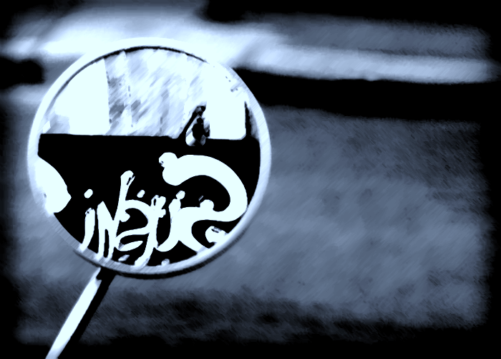
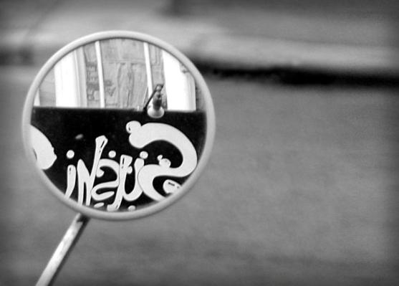
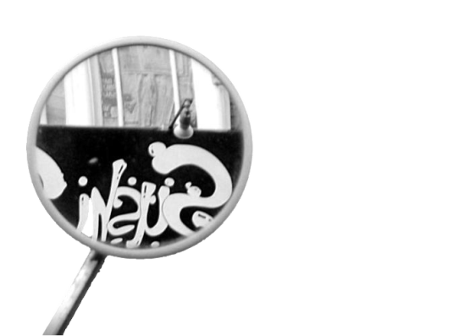
Dramatic effects can be achieved by layering an object over the same image with artistic effects

Slide 17

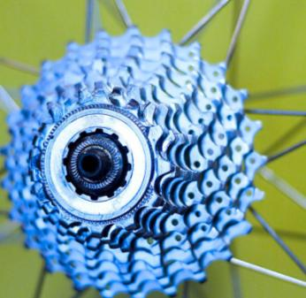

Snapshots
Mechanical Flower
New layouts bring
creativity to your presentation

Slide 18

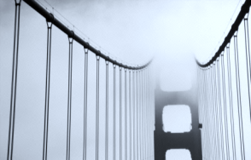
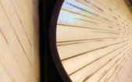
Slide Film

Slide 19


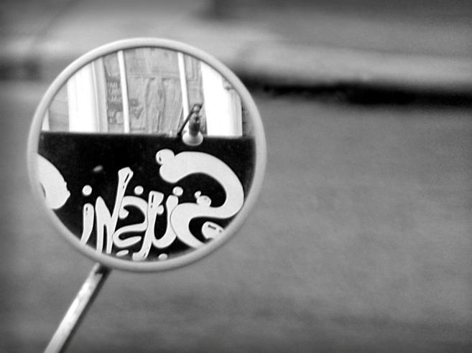


Photo Corners

Slide 20

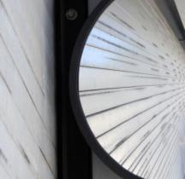
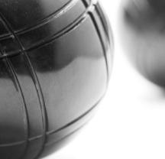
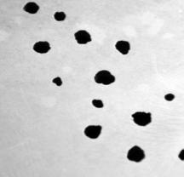
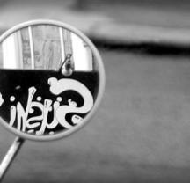

PROFESSIONAL
DYNAMIC
ABSTRACT
SOPHISTICATED
CREATIVE
MODERN

Slide 21

Split Picture
Use transitions to add something special to your photo album

Slide 22

Split Picture

Slide 23
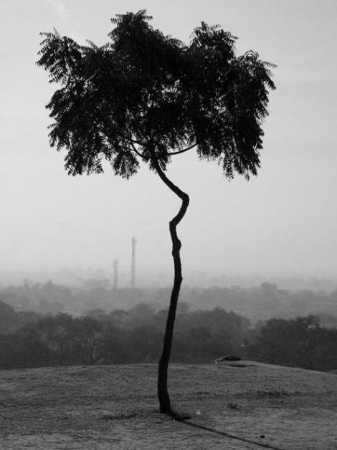

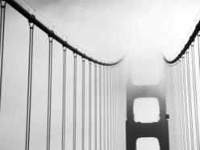
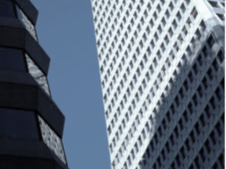

Slide 24
Urban Photo Album
Notes:
This template can be used as a starter file for a photo album.

Slide 25
NEW PICTURE EFFECTS
Introducing

Slide 26
Before
After
Tone
Saturation
Color
You can use Picture Color to change the tone or saturation of your picture or to recolor it to a single color

Slide 27
Before
After
Contrast
Brightness
Sharpness
Corrections allow you to change the contrast, brightness, and sharpness of your images.

Slide 28
Focus on the Star of Your Photo
Background Removal allows you to quickly and easily remove backgrounds to isolate items in your image.

Slide 29
By layering multiple objects on a different background, you can create dynamic layouts

Slide 30
Dramatic effects can be achieved by layering an object over the same image with artistic effects

Slide 31
Snapshots
Mechanical Flower
New layouts bring
creativity to your presentation

Slide 32
Slide Film

Slide 33
Photo Corners

Slide 34
PROFESSIONAL
DYNAMIC
ABSTRACT
SOPHISTICATED
CREATIVE
MODERN

Slide 35
Split Picture
Use transitions to add something special to your photo album

Slide 36
Split Picture

Slide 38
Urban Photo Album
Notes:
This template can be used as a starter file for a photo album.

Slide 39
NEW PICTURE EFFECTS
Introducing

Slide 40
Before
After
Tone
Saturation
Color
You can use Picture Color to change the tone or saturation of your picture or to recolor it to a single color

Slide 41
Before
After
Contrast
Brightness
Sharpness
Corrections allow you to change the contrast, brightness, and sharpness of your images.

Slide 42
Focus on the Star of Your Photo
Background Removal allows you to quickly and easily remove backgrounds to isolate items in your image.

Slide 43
By layering multiple objects on a different background, you can create dynamic layouts

Slide 44
Dramatic effects can be achieved by layering an object over the same image with artistic effects

Slide 45
Snapshots
Mechanical Flower
New layouts bring
creativity to your presentation

Slide 46
Slide Film

Slide 47
Photo Corners

Slide 48
PROFESSIONAL
DYNAMIC
ABSTRACT
SOPHISTICATED
CREATIVE
MODERN

Slide 49
Split Picture
Use transitions to add something special to your photo album

Slide 50
Split Picture

